Slide 1
Hypersonic Flow Modelling using Ansys Fluent Version: 2024R1

Slide 2
Introduction
Hypersonic flow refers to the flow of fluid over a body at speeds typically Mach 5 (five times the speed of sound) or higher. This regime of fluid dynamics is characterized by several unique and complex phenomena, such as:
1. High Temperature Effects
2. Shock Waves
3. Viscous Interaction
4. Entropy Layer
5. Real Gas Effects
At hypersonic speeds, the kinetic energy of the flow is converted into thermal energy, leading to extremely high temperatures. This can cause chemical reactions, ionization, and dissociation of air molecules.
Hypersonic flow generates strong shock waves that can significantly affect the aerodynamic forces and heating on a vehicle. The shock layer is very thin and the shock waves are intense.

Slide 3
Introduction
The purpose of this tutorial is to compute the flow around a re-entry capsule at hypersonic speed. The simulated speed, trajectory, and ambient conditions are representative of such a vehicle as it passes through the earth’s atmosphere at an altitude of approximately 50 [km].
This tutorial demonstrates how to do the following:
• Creation of capsule mesh using Watertight Geometry workflow.
• Model hypersonic flow, using high-speed numerics, appropriate models for air properties, the two-temperature model for energy to address thermal non-equilibrium, and the species model to address the chemical non-equilibrium.
• Set boundary conditions for external aerodynamics.
• Use the k-ω SST turbulence model.
• Calculate a solution using the density-based coupled solver.
Note: This Simulation runs with cfd_hsf license increment.
“Please ensure that you have hsf library before working on this tutorial.”

Slide 4
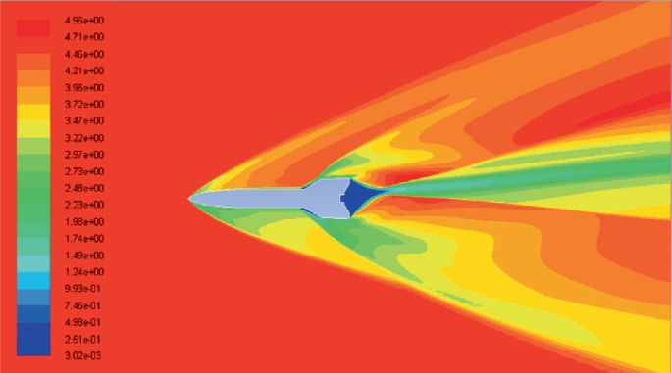
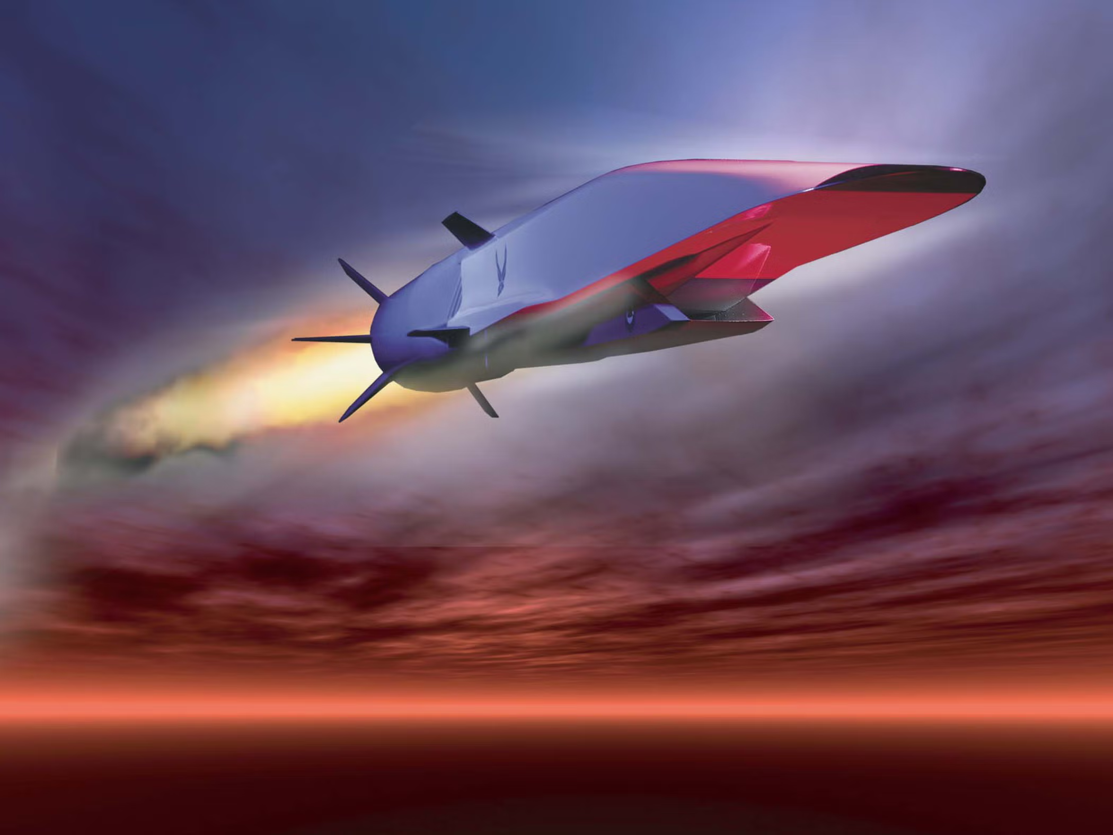
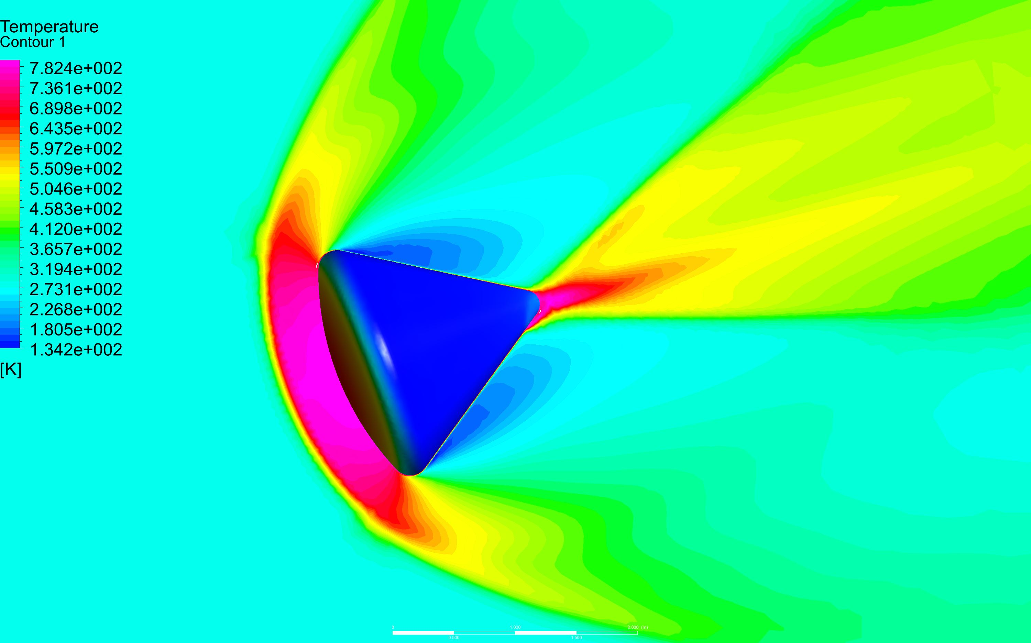
Introduction
Hypersonic flow is relevant to various applications, including:
Reentry Vehicles: Spacecraft reentering the Earth's atmosphere, such as the Space Shuttle or crew capsules, encounter hypersonic speeds.
Hypersonic Missiles and Aircraft: Military applications focus on developing hypersonic missiles and aircraft for rapid strike capabilities and evasion of defenses.
Space Exploration: Hypersonic speeds are involved in missions on other space entities.

Slide 5
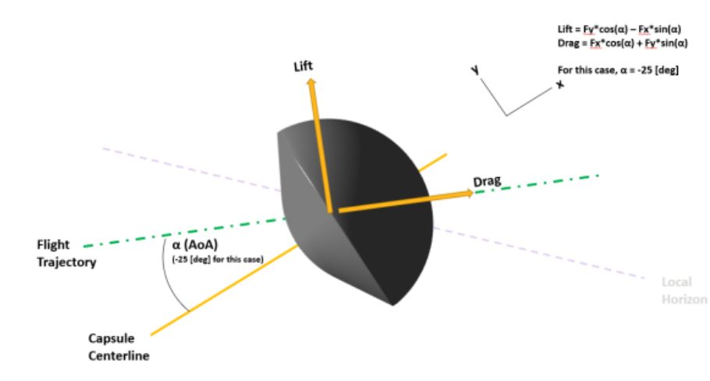
Problem Description
The problem considers the flow around a re-entry capsule at an angle of attack α=-25° and a free stream Mach number of 17.0. The geometry of the capsule is shown in Figure below which also shows the lift and drag directions for the given case. The flow around the capsule can be assumed to be symmetric for this tutorial.

Slide 6
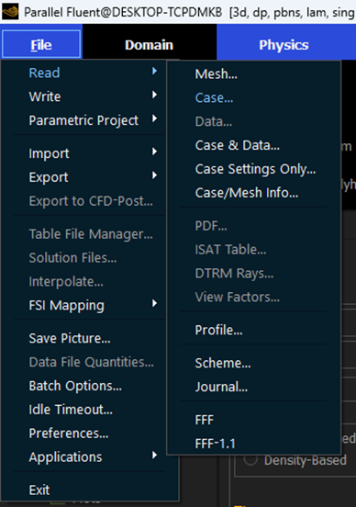
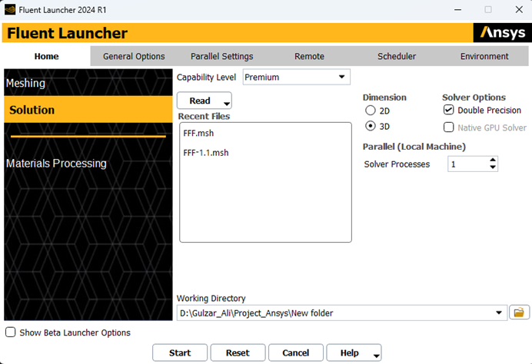
Setting up Simulation Environment
Download the case files for Ablation Modelling
Read the case files using ansys Fluent
Top left corner of fluent window. Read the case file provided with this tutorial.

Slide 7
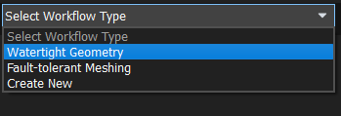

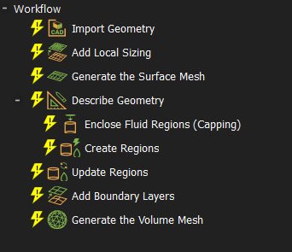
Meshing Workflow
Run Fluent in meshing mode > Select Watertight geometry

Slide 8
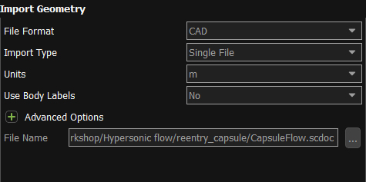
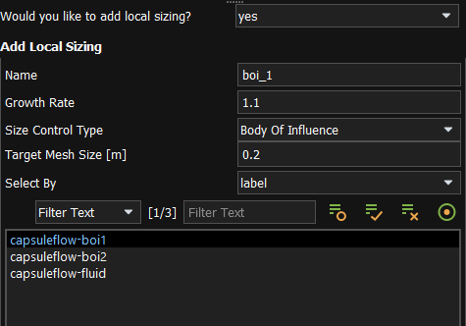
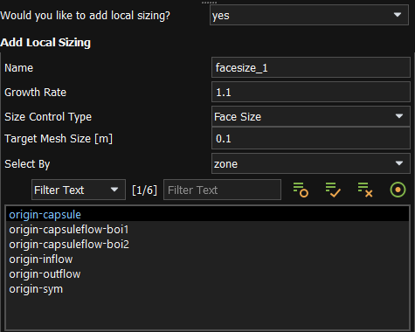
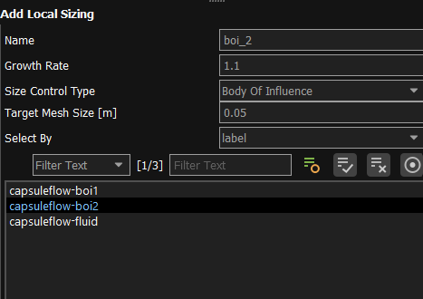
Meshing Workflow
Complete these steps

Slide 9
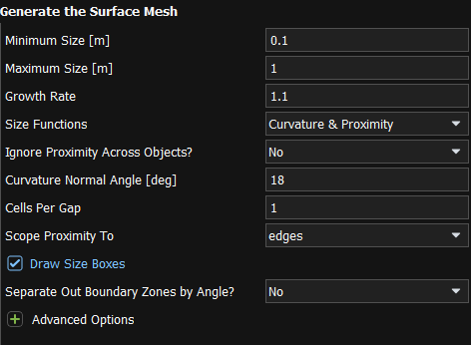
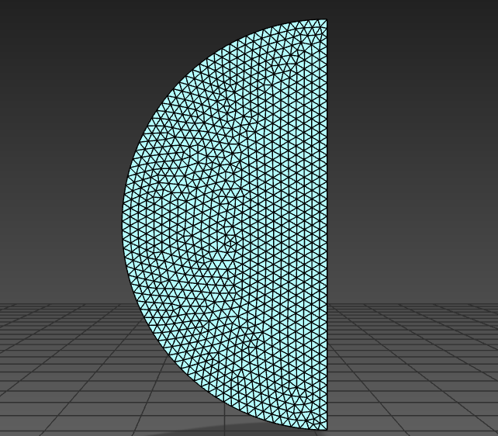
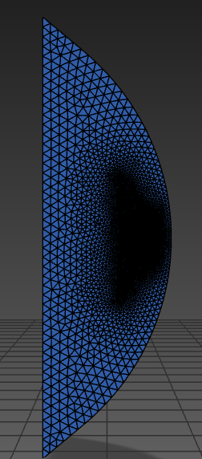
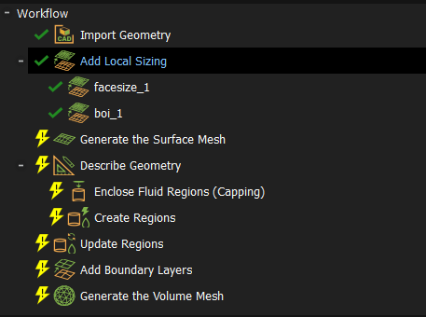
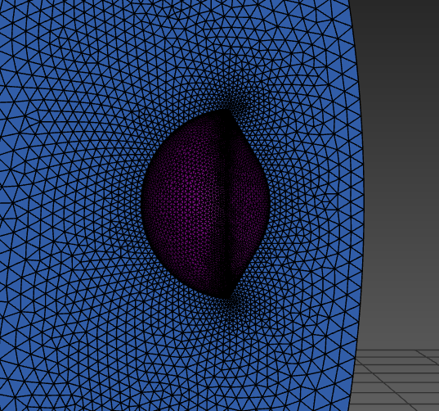
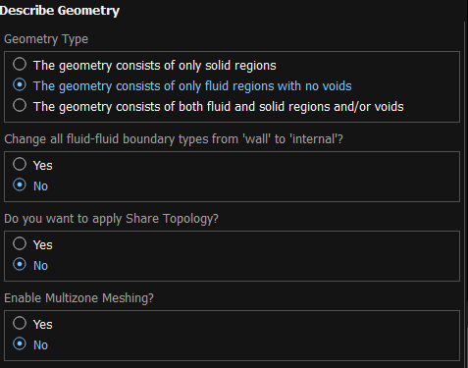
Meshing Workflow
Complete these steps

Slide 10
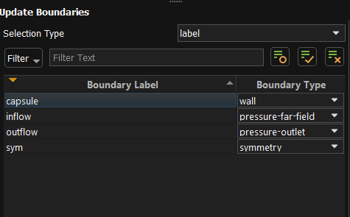
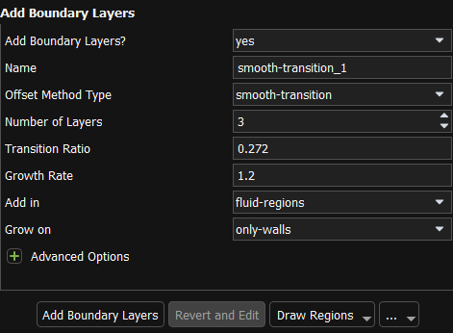
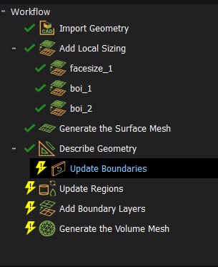
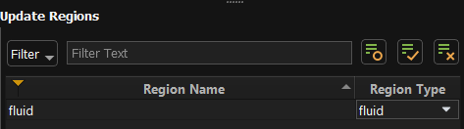
Meshing Workflow
Complete these steps

Slide 11
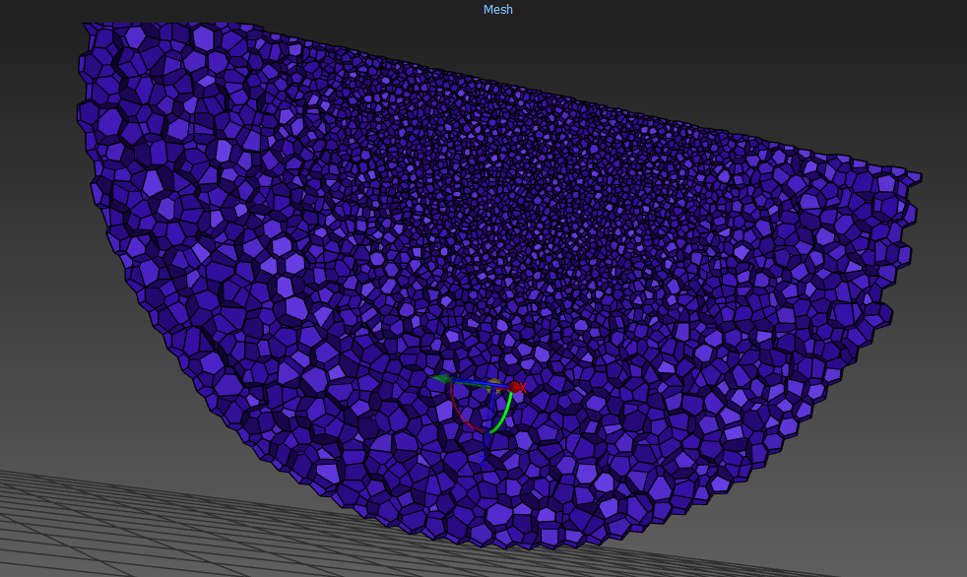
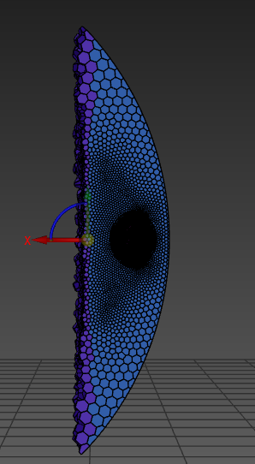
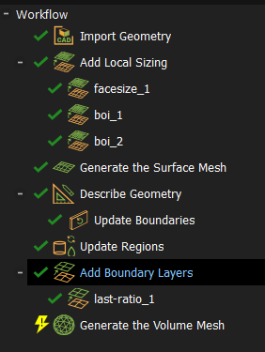
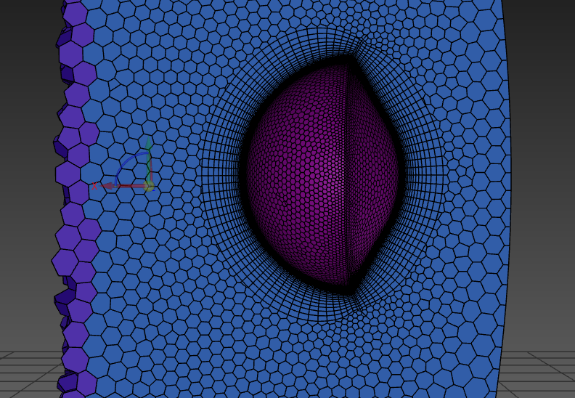
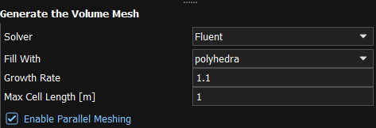
Meshing Workflow
Complete these steps

Slide 12
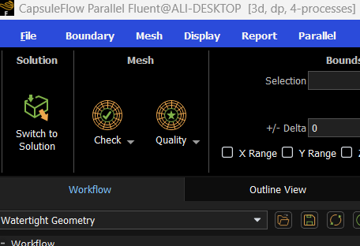
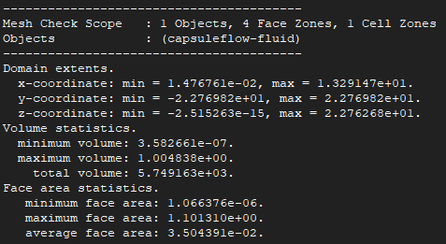
Setting up Simulation
Perform Mesh Check > Switch to Solution Mode
Ensure that there is no error in Mesh Checking before entering solution mode
If you are working on already written case-file then you can start from here and skip the mesh workflow.

Slide 13
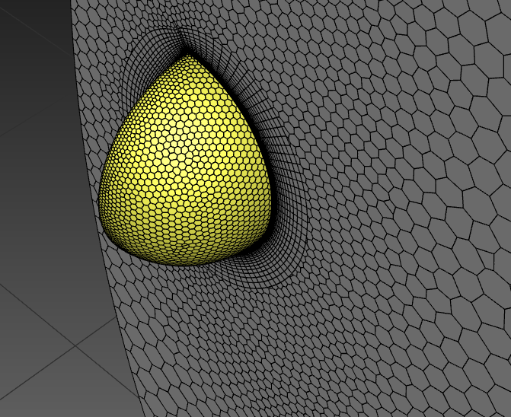
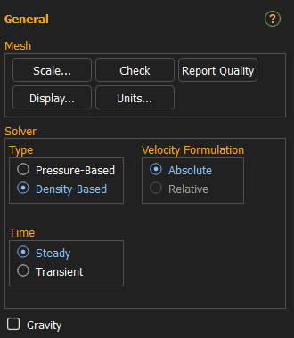
Setting up Simulation
Visualize the mesh > Set the Solver Settings

Slide 14
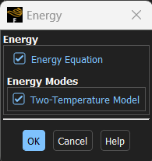
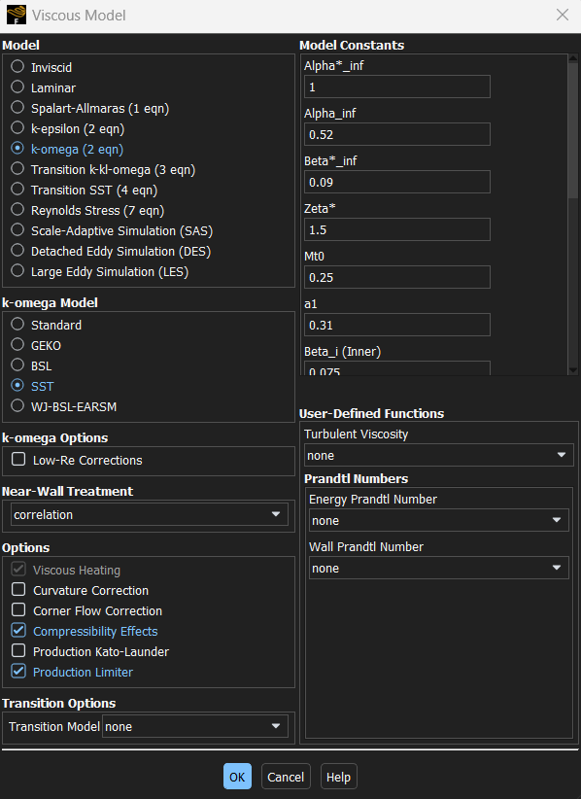
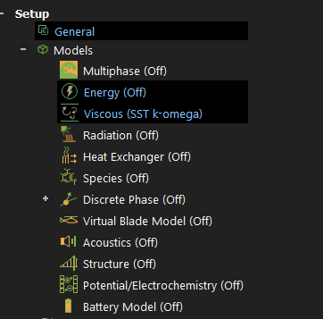
Setting up Simulation
Set the Solver Settings

Slide 15

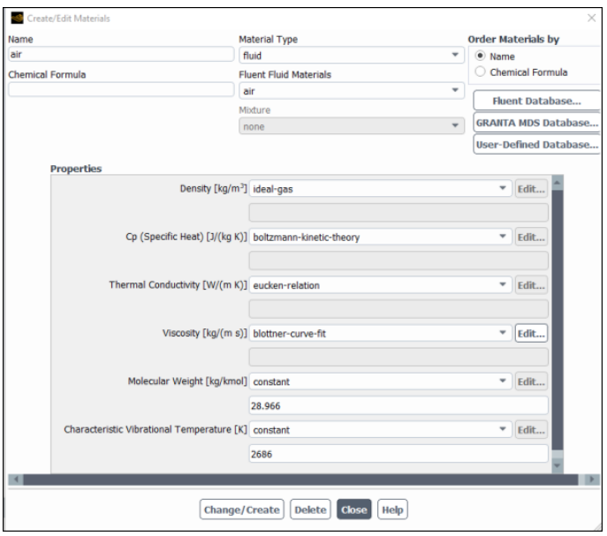

Materials
Properties for air that are set automatically in conjunction with the selection of the Two-temperature Model.

Slide 16
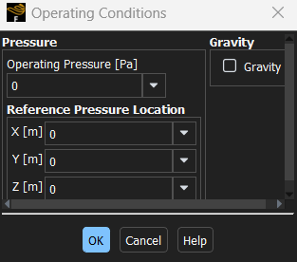
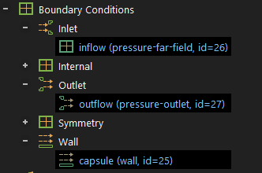
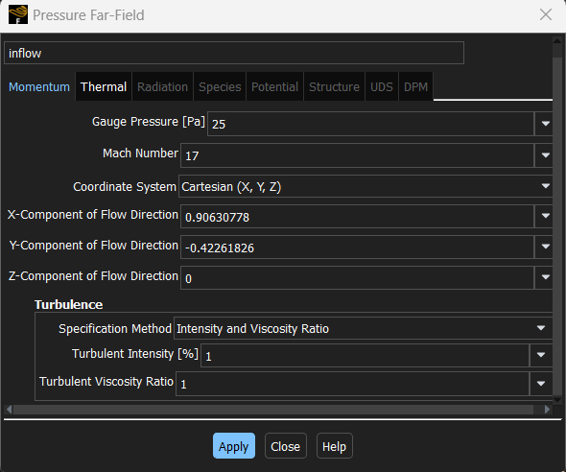
Boundary Conditions
Setup Operating Conditions > Define Boundary Conditions
Set Temperature at 250 K
These values are determined by the -25° angle of attack:
cos -25°= 0.90630778
sin -25° = -0.42261826.

Slide 17
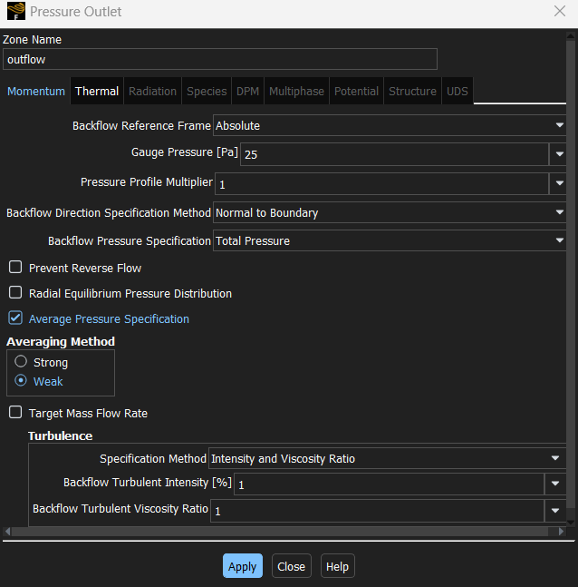
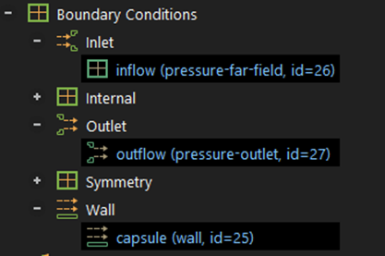

Boundary Conditions
Set Temperature at 250 K
Define Boundary Condition

Slide 18
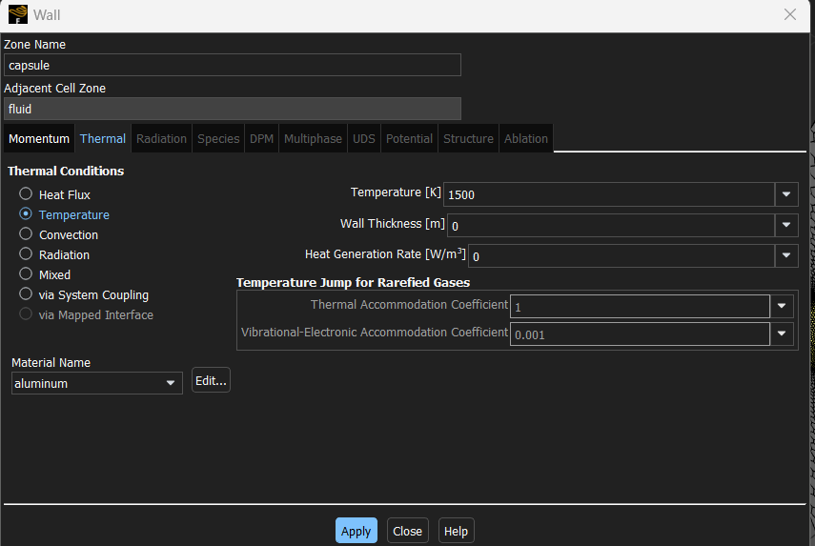
Boundary Conditions
Define Boundary Condition

Slide 19
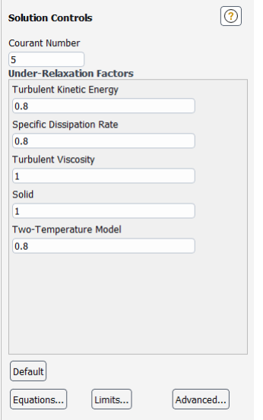
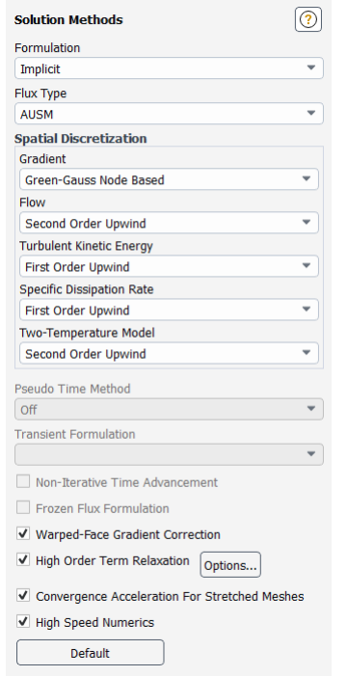
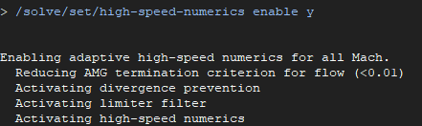

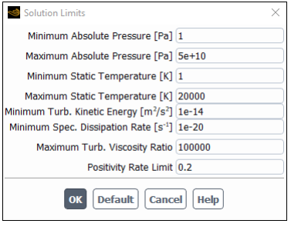
Solution Methods
Set Solution Methods
Turn on high speed numerics by entering this command in console:

Slide 20
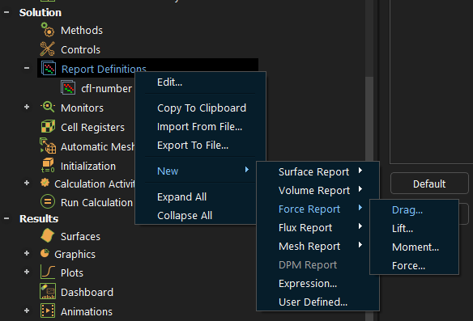
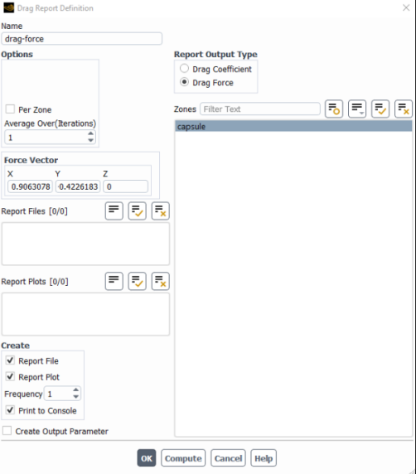
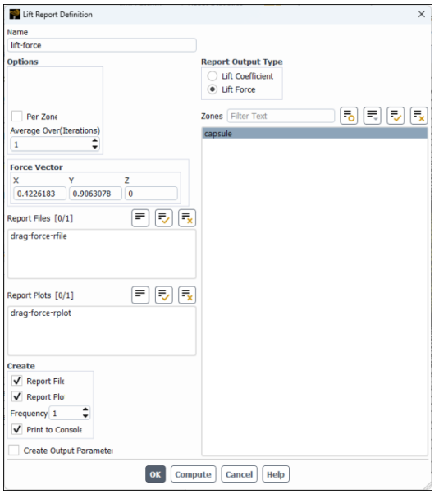
Solution Methods
Create report definitions for drag and lift force on capsule and heat transfer rate

Slide 21
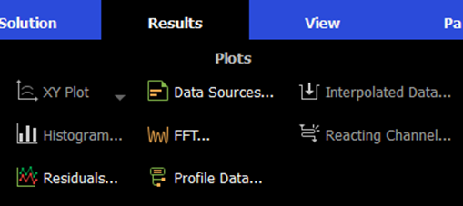
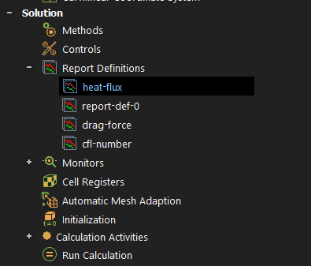


Solution Methods
Create report definitions for Total heat transfer rate and set residuals

Slide 22




Solution Methods
Initialize the solution with following settings and Run Calculation
Run the Full Multigrid (FMG) initialization.
FMG initialization often facilitates an easier start-up of a calculation, especially for hypersonic flows in which extremely strong variations and gradients are present, and the initialized solution must adapt to reflect the given boundary conditions.

Slide 23

Results and Calculations
Run the Simulations > Visualize the generated plots

